Slide 1

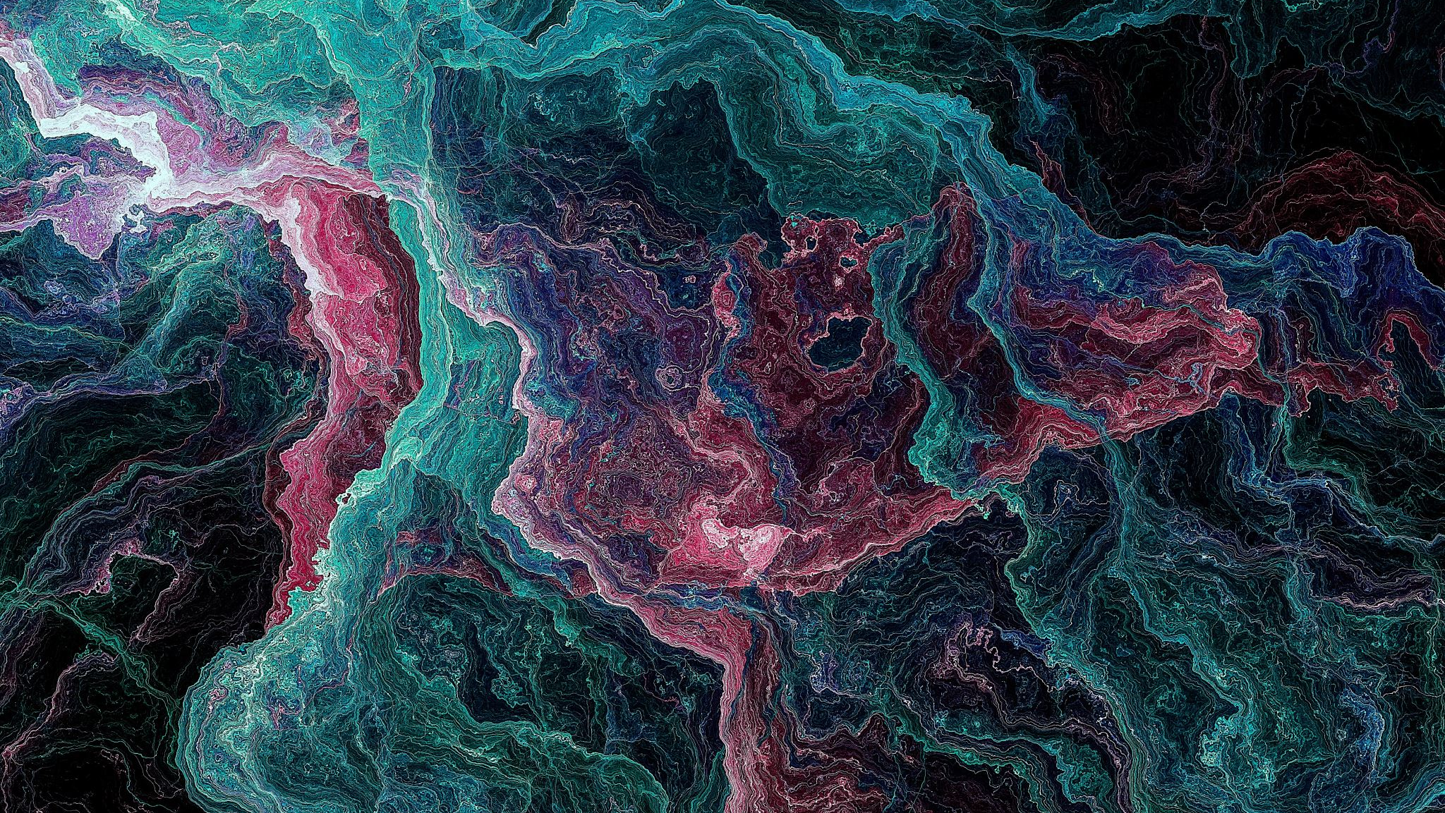
Creating Account with MongoDB Atlas

Slide 2
MongoDB is a NoSQL database that stores data in documents (JSON-like) instead of tables and rows.

Slide 3
Step 1
Create Account
Create a Cluster

Slide 4
Step 2
Create Database User
Username:Admin
Password:Strong Password
“This is like database login credentials.”

Slide 5
Step 3
Network Access
Add IP Address
Allow access from anywhere
Get Connection String

